Slide 1
Eating Responsibly
Food and Nutrition

Slide 2
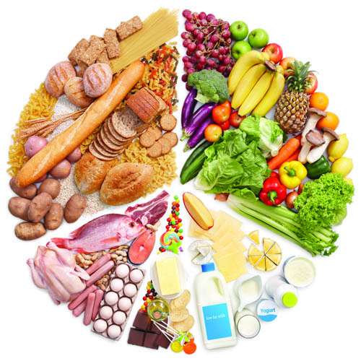
Nutrition and Your Health
Nutrition
Study of how our bodies use the food we eat
to maintain our health

Slide 3
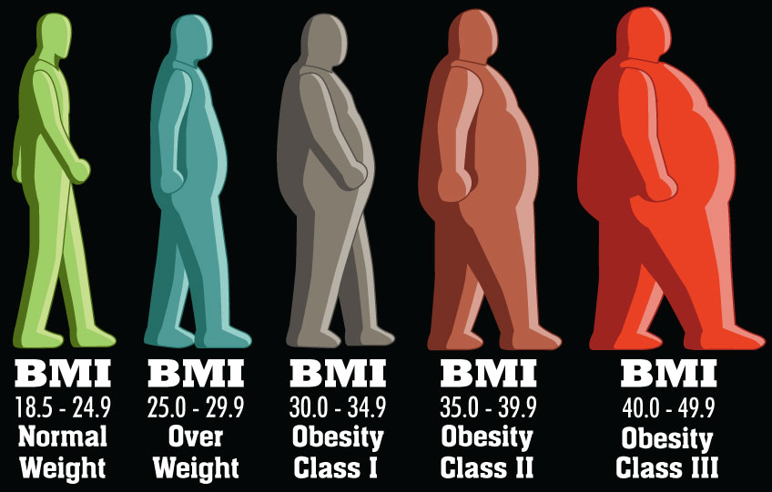
Overweight vs. Obesity

Slide 4
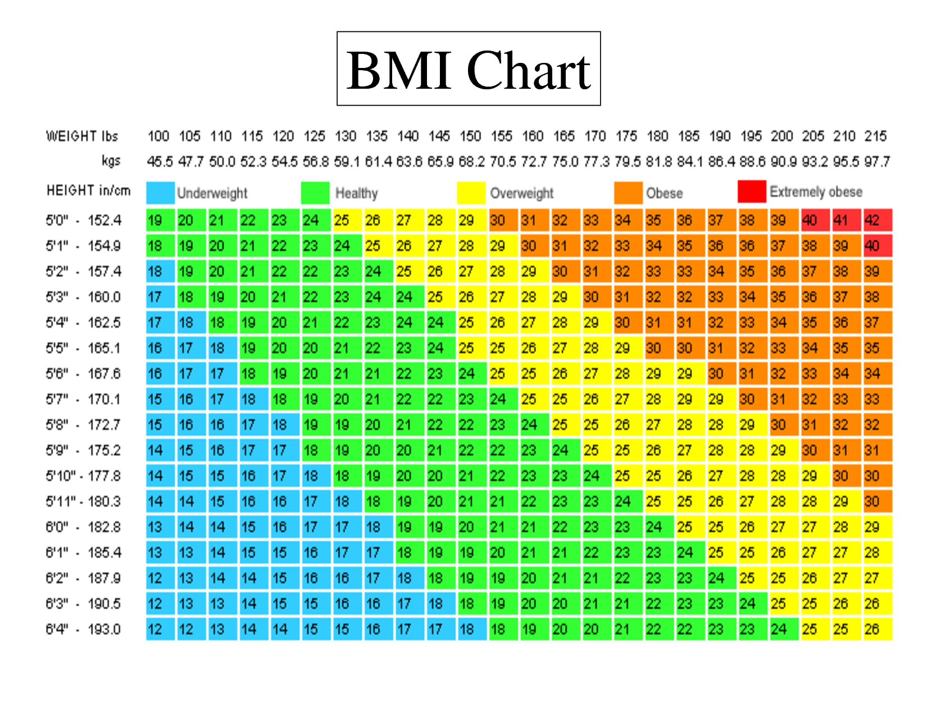

Slide 5
Calories
Amount of energy your body gets from a food
How do you burn calories?
Metabolism – process of converting the energy in food into energy your body can use

Slide 6
Caloric Intake for Teenagers
Males
Sedentary – 2,000 Calories
Moderate – 2,200 Calories
Active – 2,600 Calories
Females
Sedentary – 1,600 Calories
Moderate – 2,000 Calories
Active – 2,200 Calories

Slide 8
Nutrients
The substances in food that your body needs to function properly

Slide 9
Carbohydrates
A chemical composed of one or more simple sugars
1 gram of carbohydrates = 4 calories
Simple Carbohydrates
Sugars
Complex Carbohydrates
Starches
Fiber

Slide 10
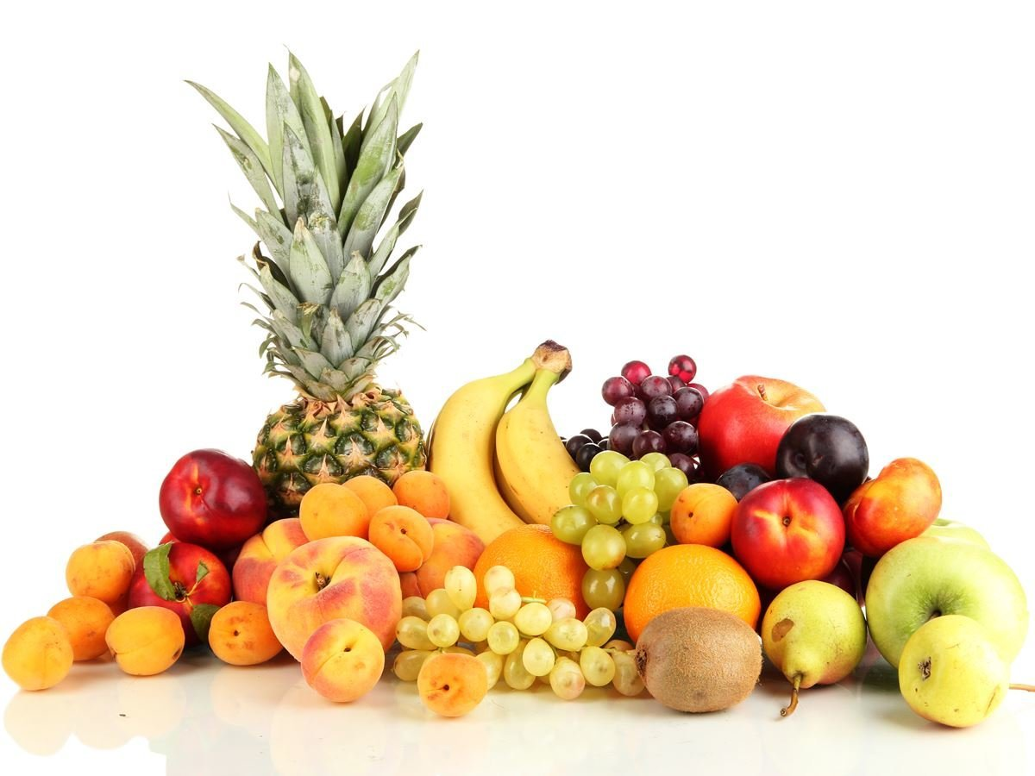
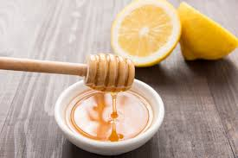
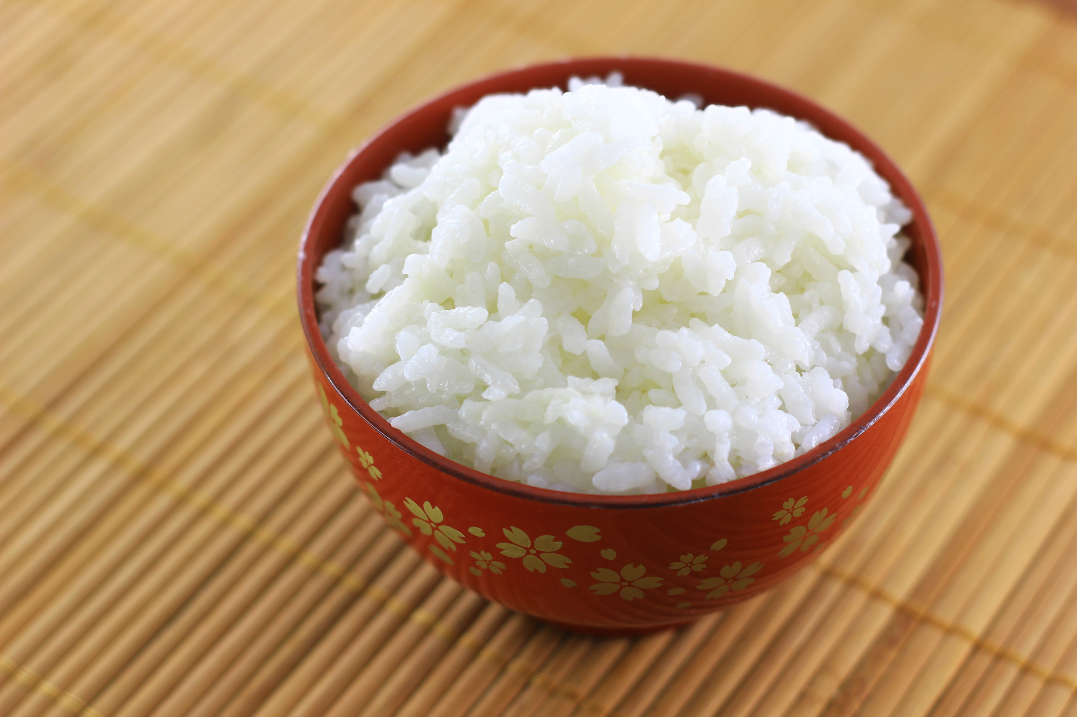
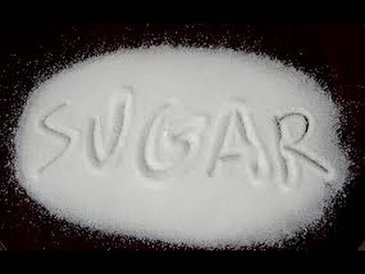
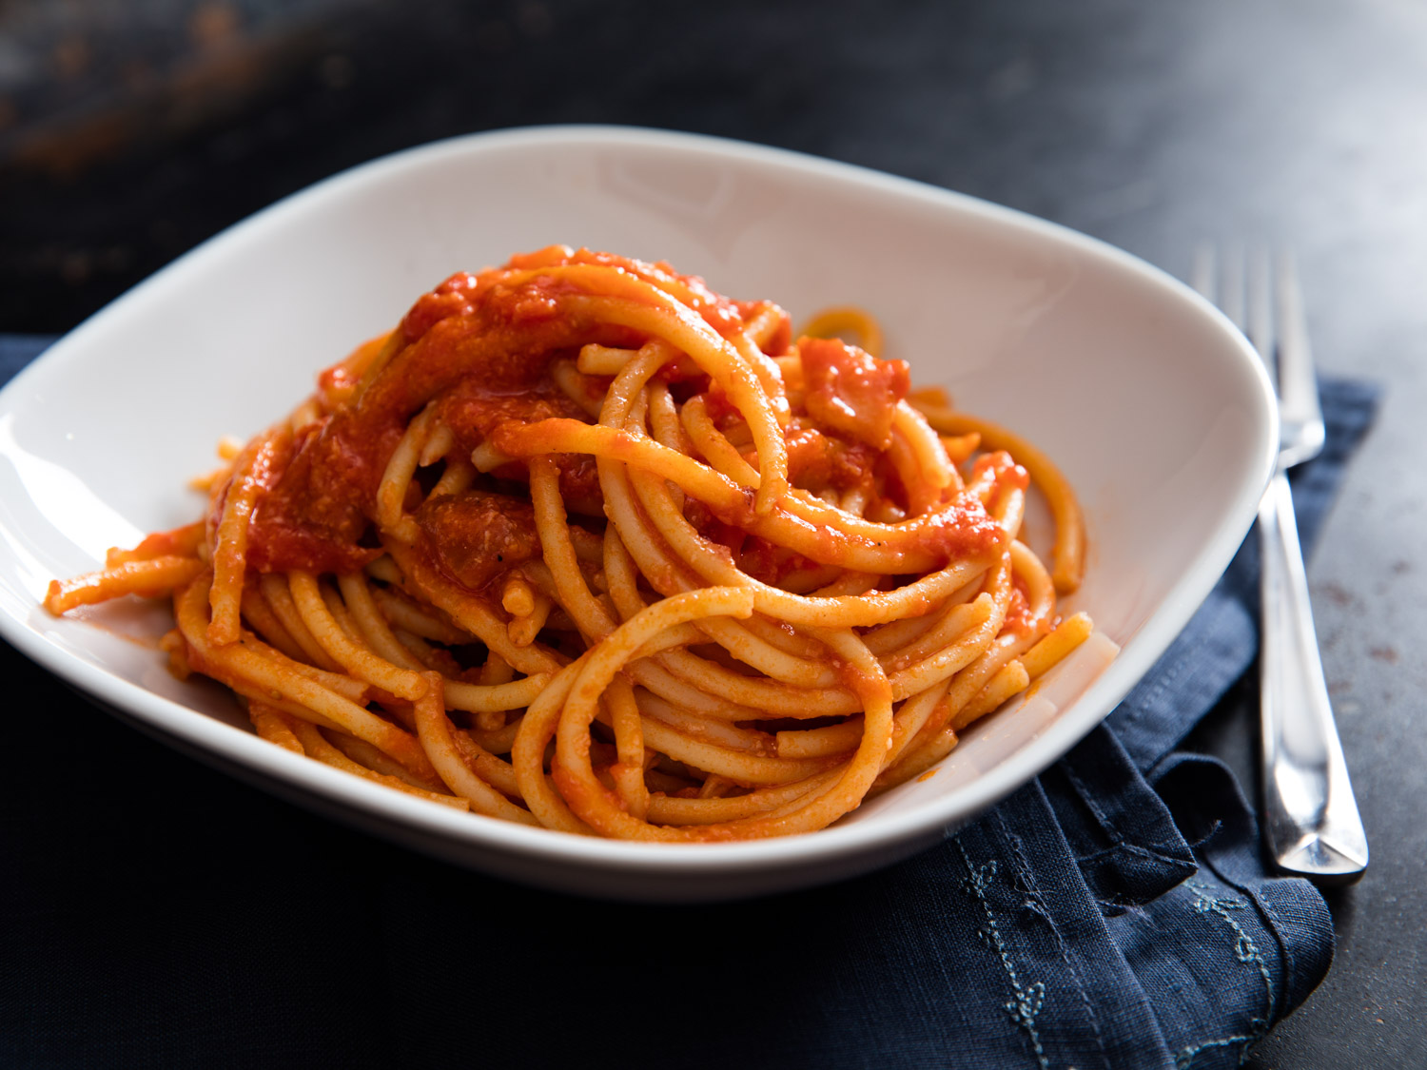
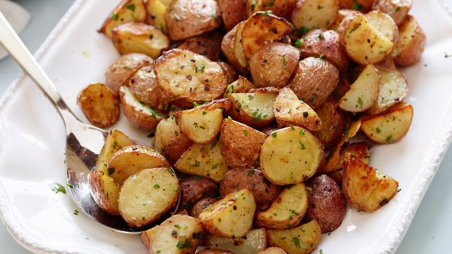
Simple Carbs vs. Complex Carbs

Slide 11
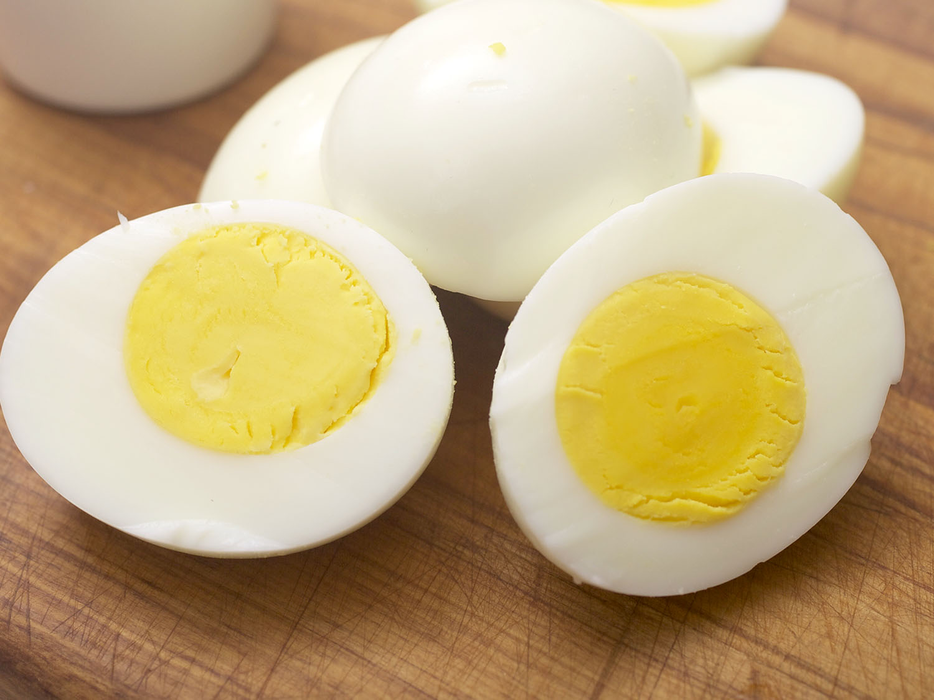
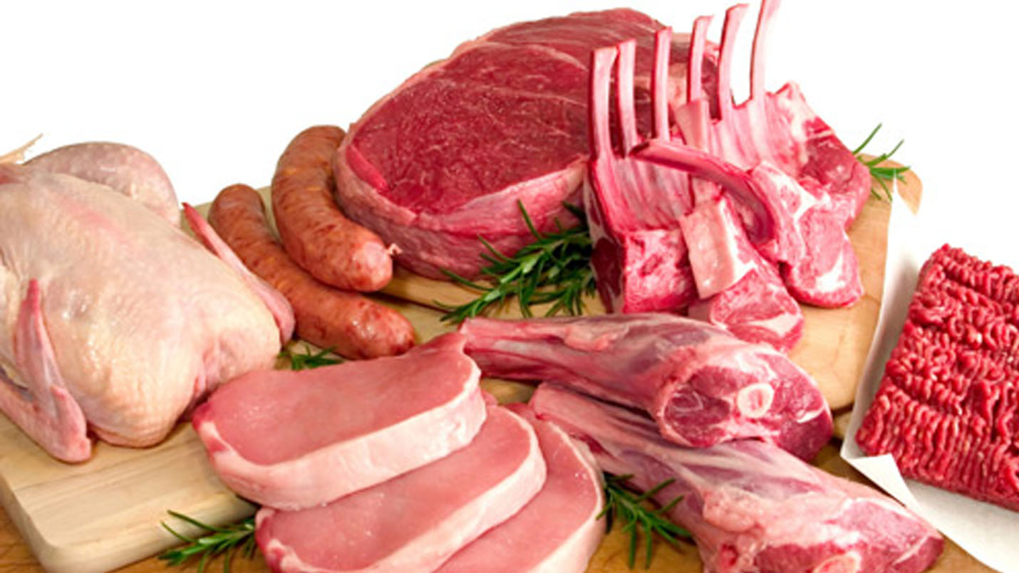
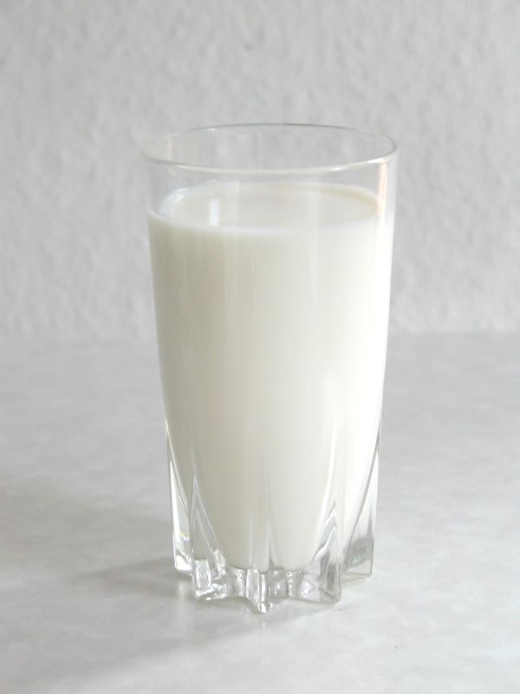
Protein
Nutrients that build and repair tissues and cells
1 gram of protein has 4 calories

Slide 12
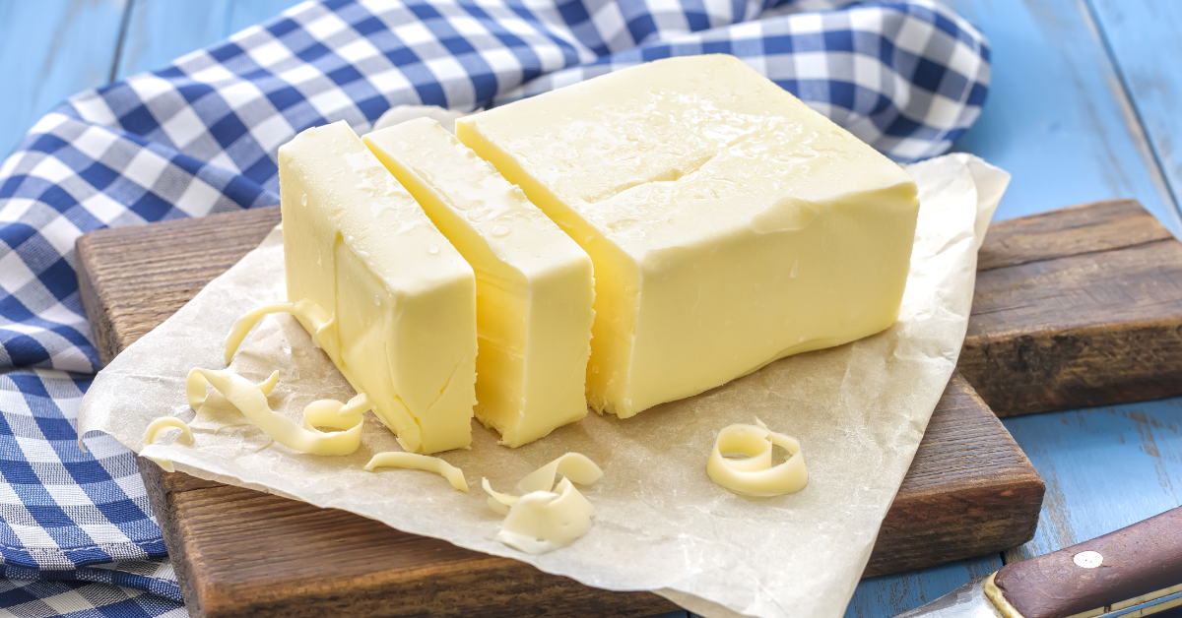
Fat
Energy storage nutrients that help the body store some vitamins
Needed in small amounts

Slide 13
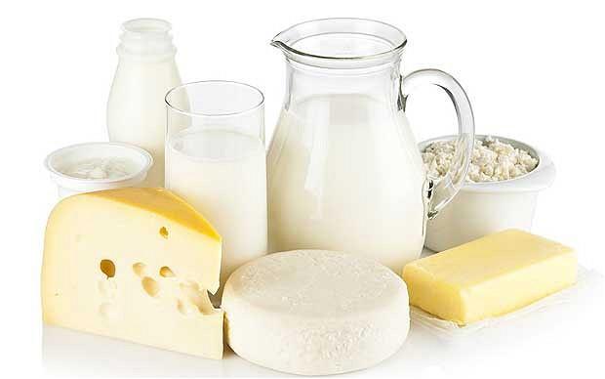
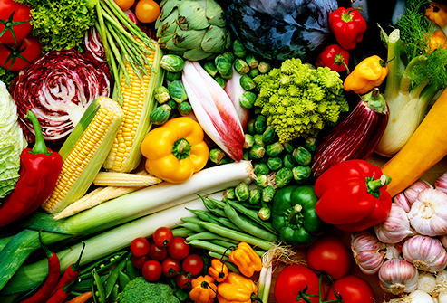
Vitamins
Organic compounds that keep your body healthy
Small Amounts

Slide 14
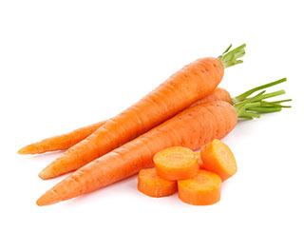
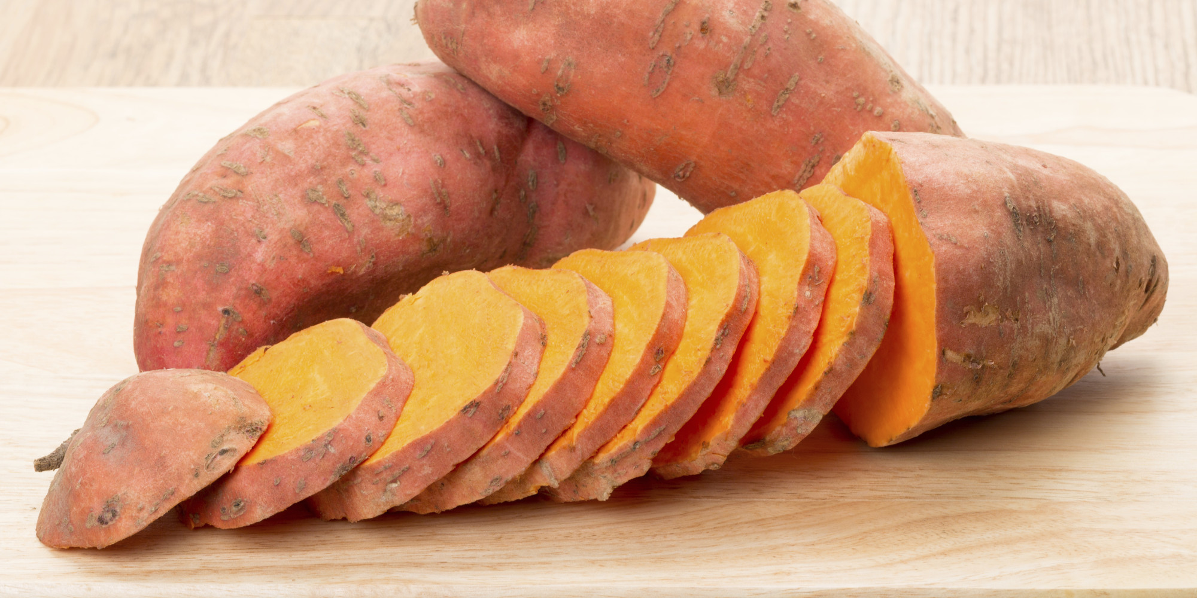
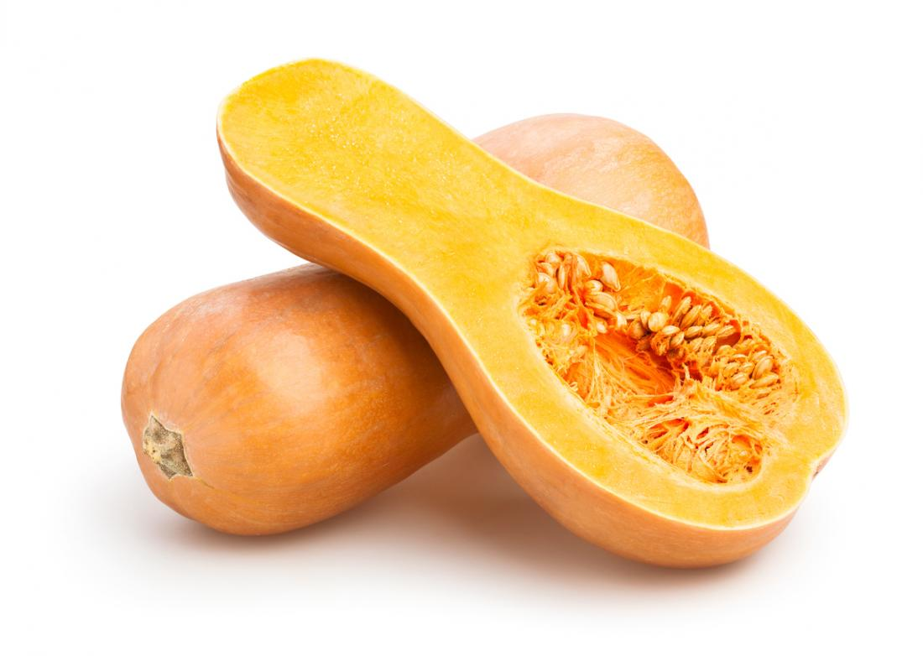
Vitamin A
Healthy Skin & Hair

Slide 15
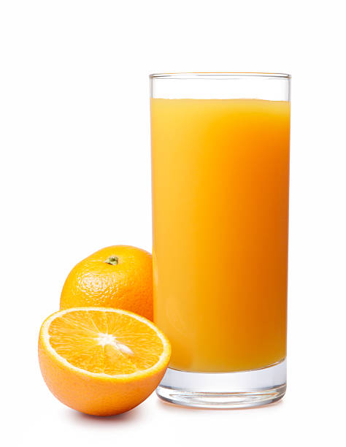
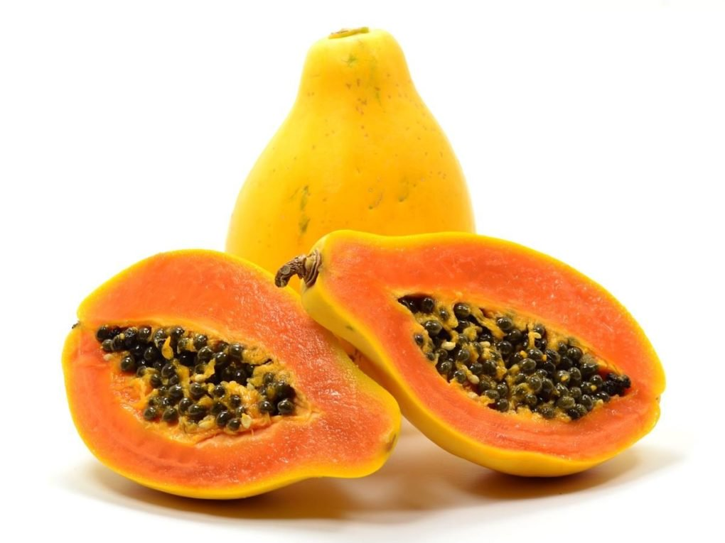
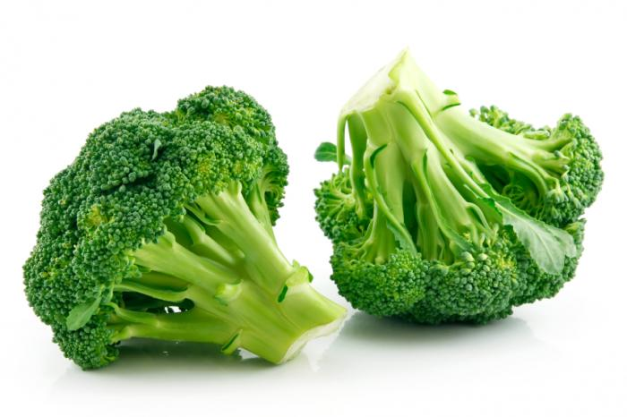
Vitamin C
Helps body fight germs that cause illness

Slide 16
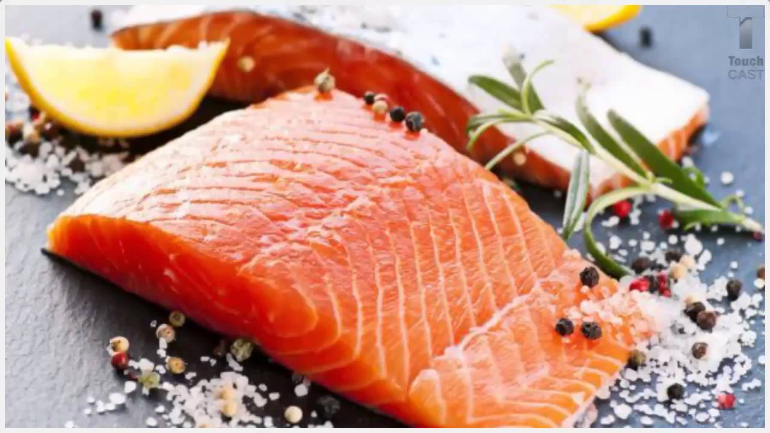
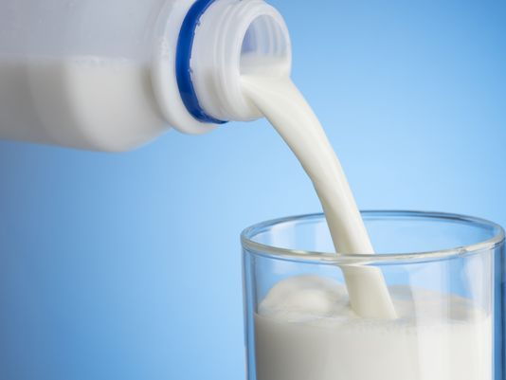
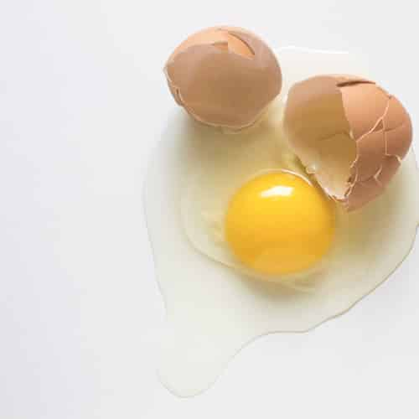
Vitamin B -12
Aids in concentration, memory, and balance

Slide 17
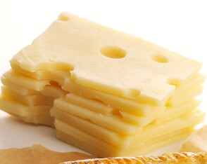
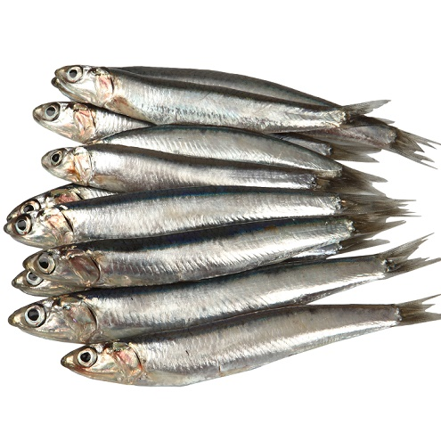
Calcium
Necessary for healthy, strong bones and teeth

Slide 18
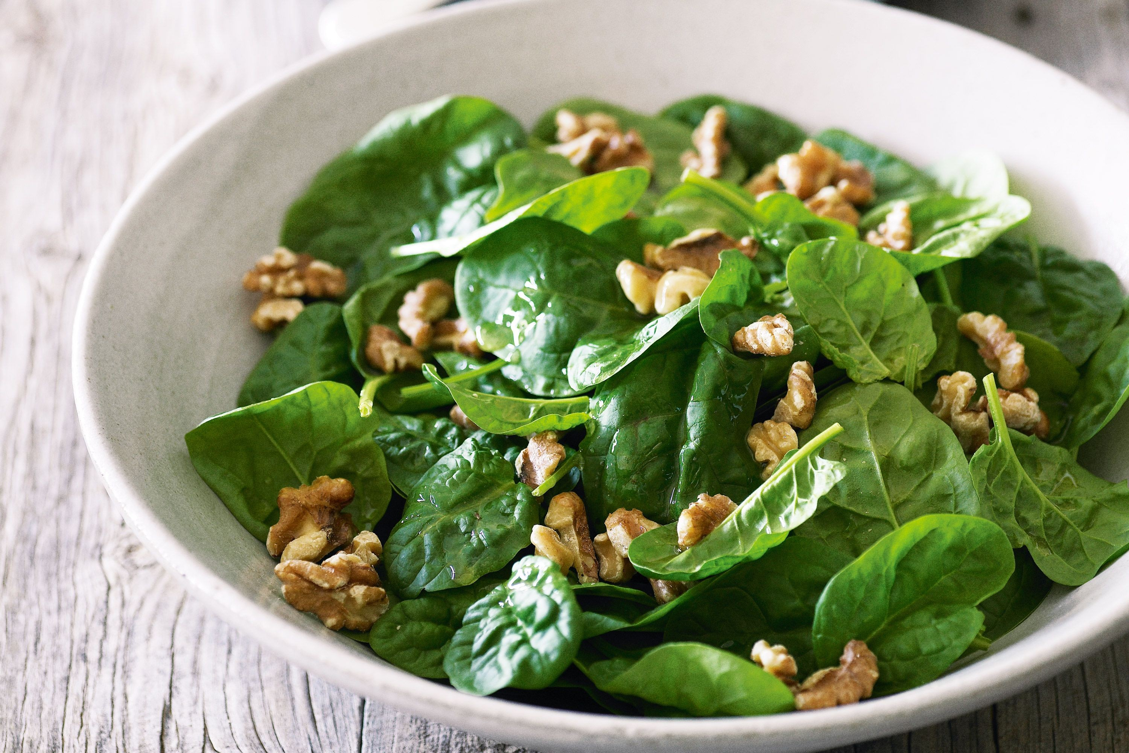
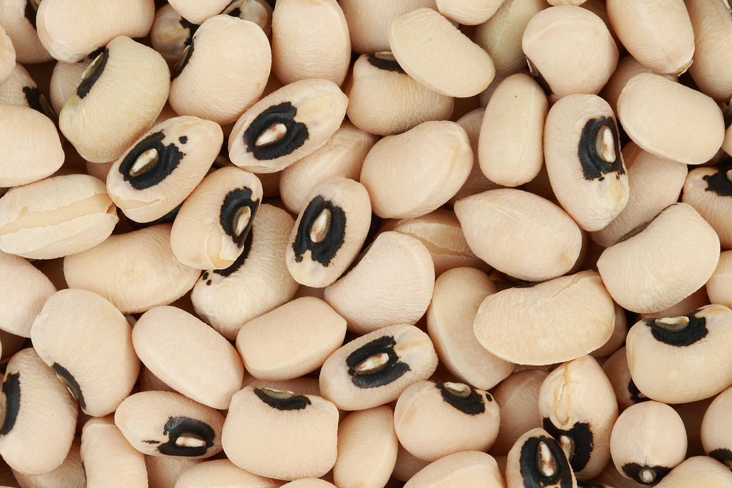
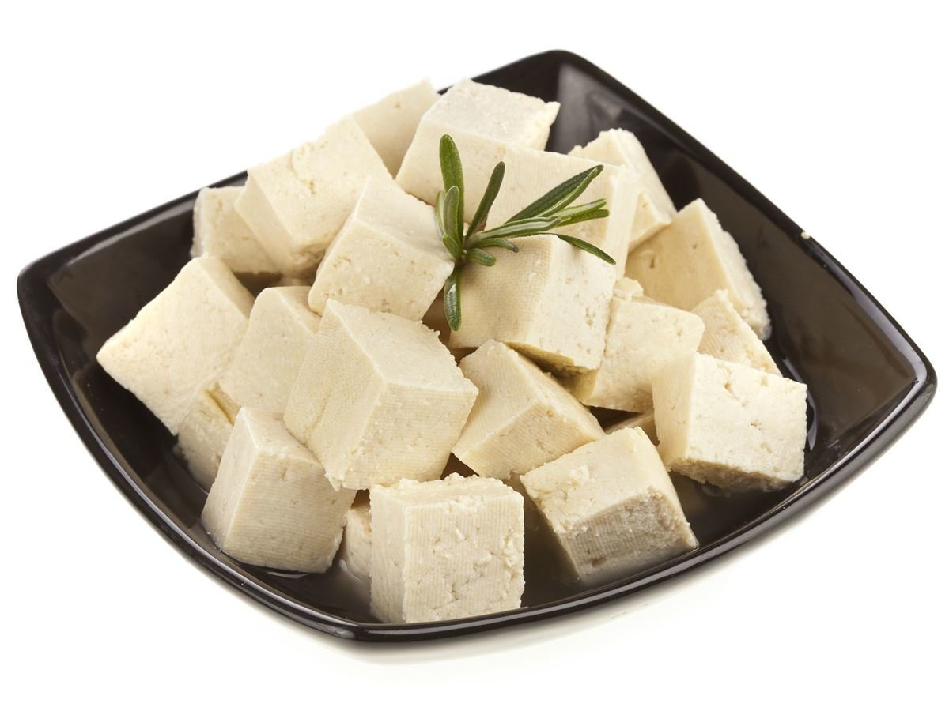
Iron
Healthy blood; prevents tiredness

Slide 19
Water
70% of your body
Can’t live more than a few days without it
Carry nutrients and waste products throughout your body
8-10 glasses per day
Dehydration

Slide 21
Nutrition Facts Label
Label found on the outside of food packages of food and states the number of servings in the container, the number of calories in each serving, and the quantity of nutrients in each serving.

Slide 22
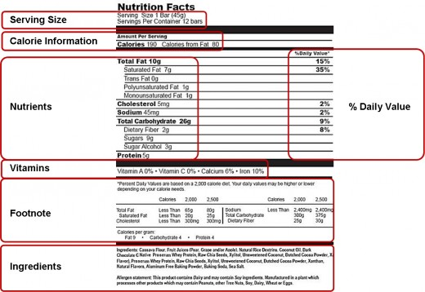

Slide 23
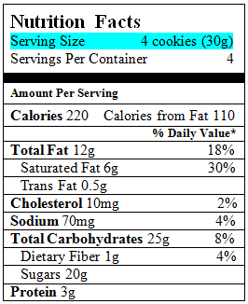
Serving Size
Standard amount of food that allows different foods to be compared with one another

Slide 24
Visualizing 1 Serving

Slide 25
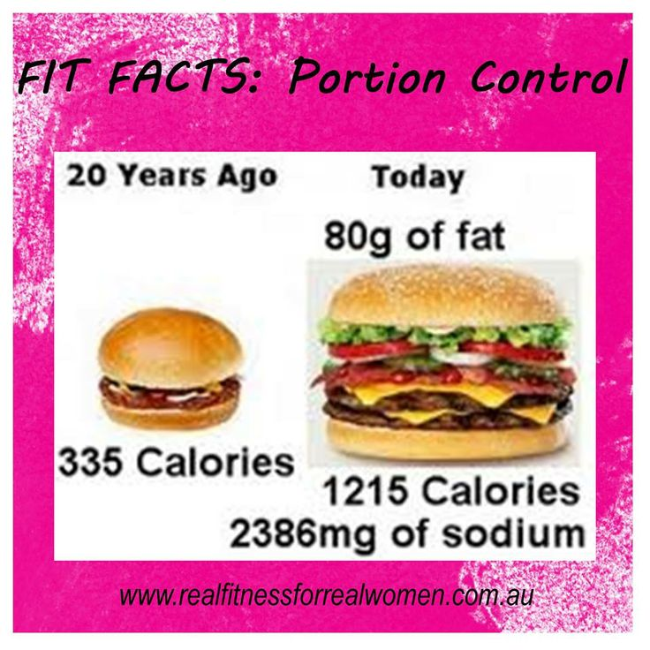
Portions
Amount of food that a person wants to eat

Slide 26
Guess the Calories Difference
https://www.slideshare.net/alicehenneman/portion-distortion

Slide 27
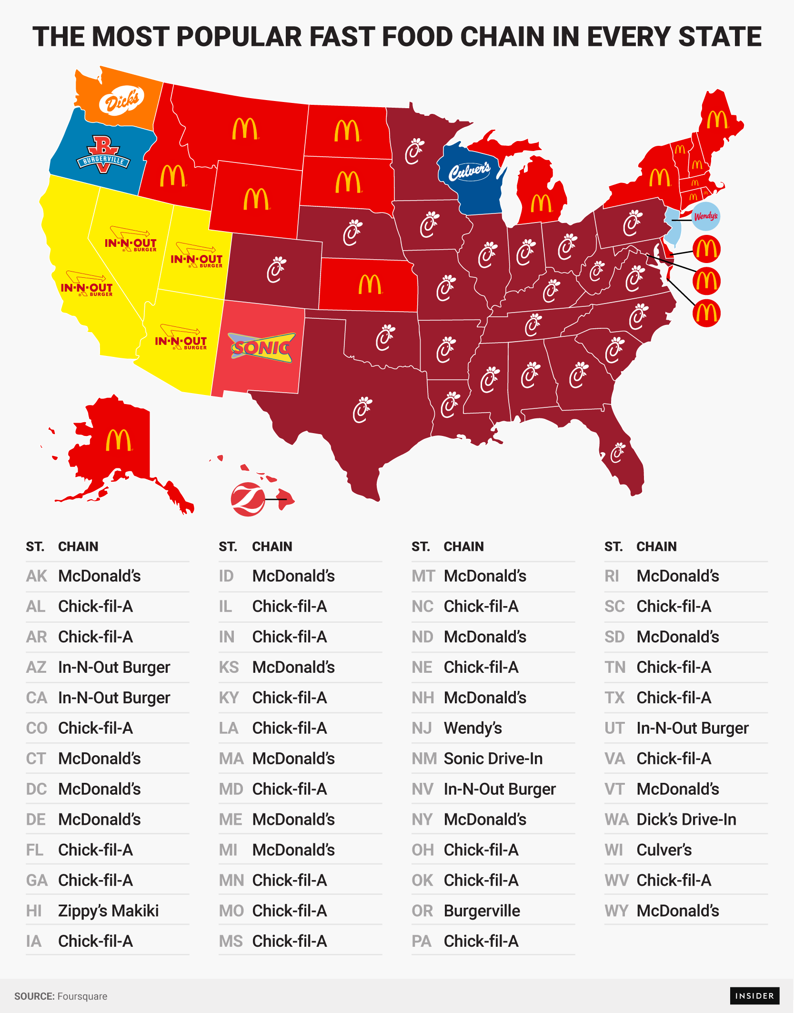

Slide 28
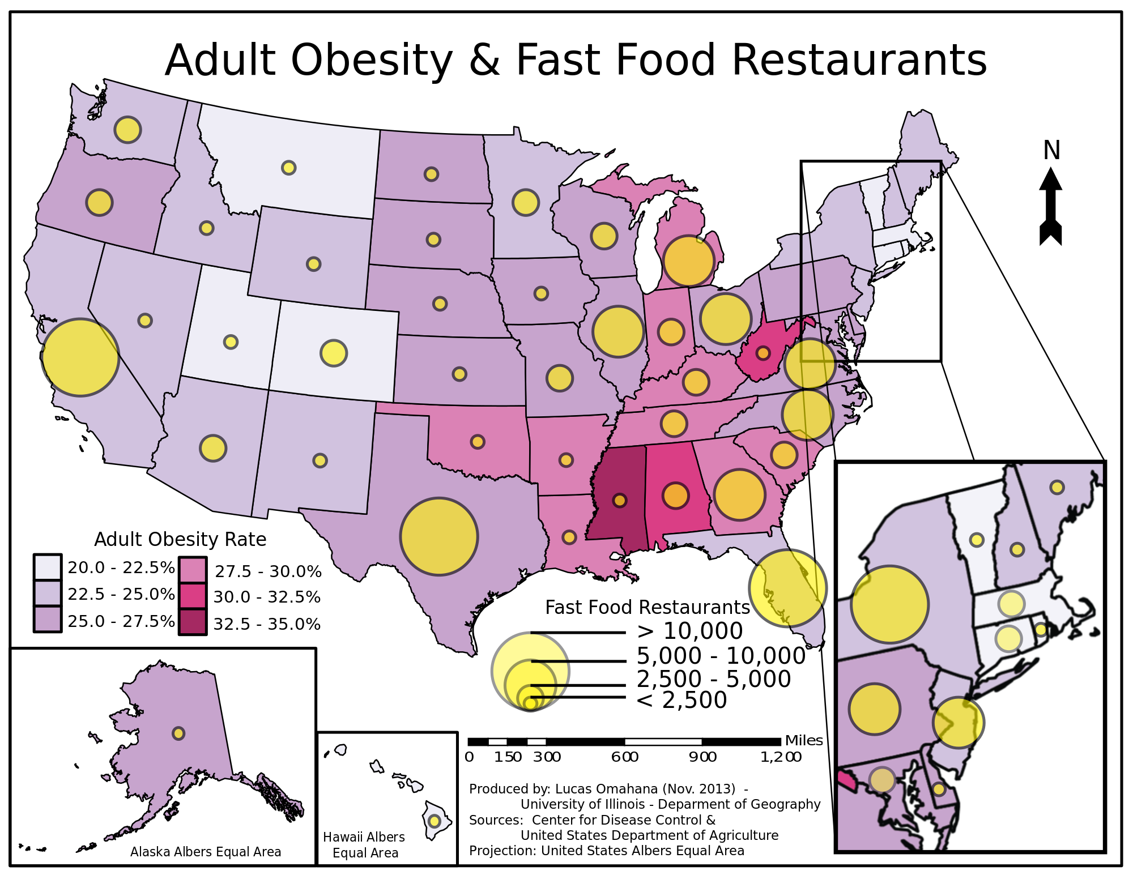

Slide 29
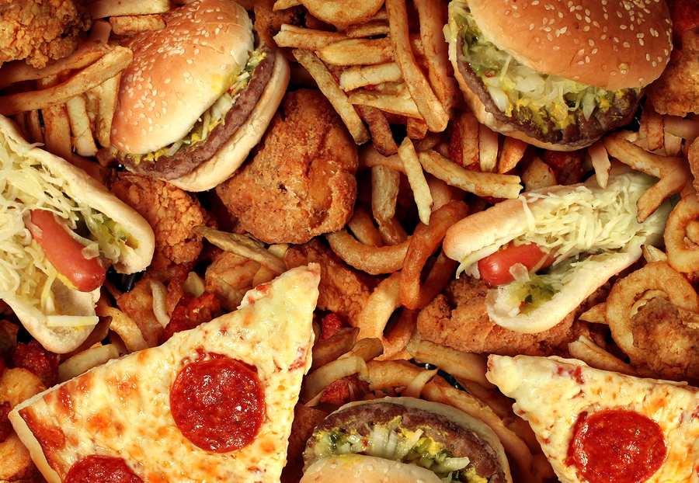
Fast Food Fat & Calories
Trans Fat
Increase risk of heart disease and high cholesterol
Fried Foods
5 or more grams of Trans Fat
Saturated Fat
High Cholesterol
Double Whopper – 33 grams

Slide 30
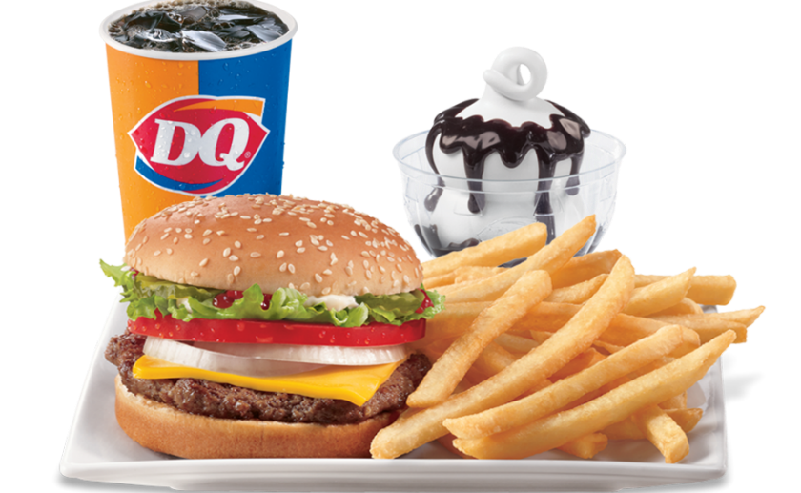
Fast Food Fat
1 Teaspoon of Crisco = 5 grams of fat
McDonalds Big Mac –
Meat Lover’s Personal Pan Pizza –
Wendy’s Baconator –
Arby’s Roast Beef & Cheddar –
Subway Chicken Bacon Ranch --

Slide 31
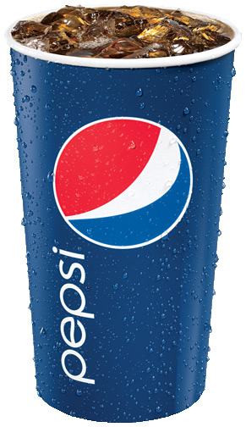
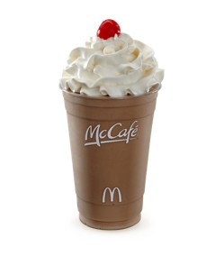
Sugars
Leads to weight gain & obesity
Soda
Milkshakes
Stay between 6 & 9 grams

Slide 32
Sodium
Consumption per day – 1,500mg to 2,300mg
Wendy’s Chicken Nuggets – 679milligrams
Burger King Double Whopper with Cheese – 1,544 milligrams
McDonald’s Large Fries – 350 milligrams
Burger King Vanilla Medium Shake – 400 milligrams

Slide 33
Body Image
How you feel and see your body
Self Esteem
How much you value, respect, and feel confident about yourself

Slide 34
Unhealthy Eating Behaviors
Why Teens Develop Unhealthy Eating Behaviors
Low Self Esteem
Fear of becoming overweight
Poor skills for coping with stress
Unhealthy body image
Pressure from friends or family to be thin
Feelings of helplessness

Slide 35
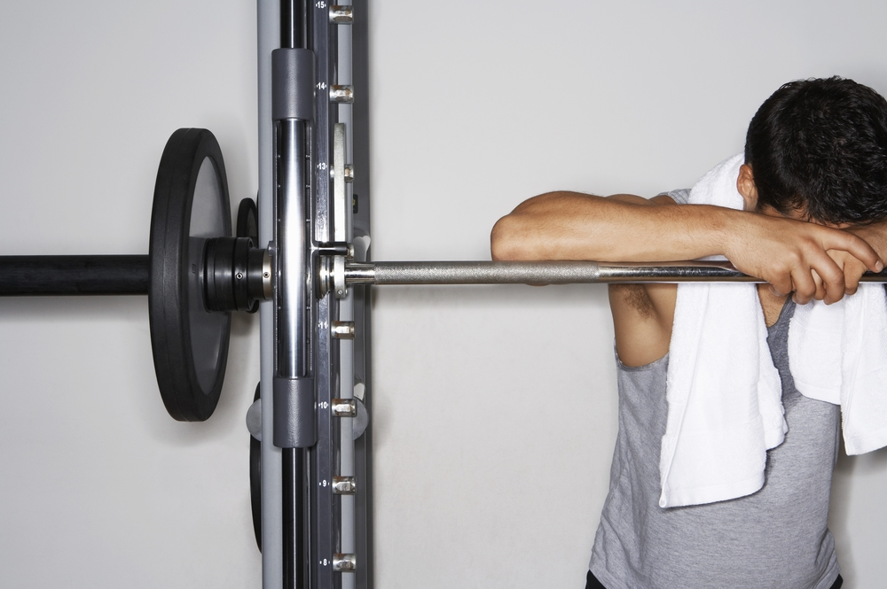
Overexercising
Concerned about body & weight
Exercises more intensely and for a longer period of time than is necessary for good health
Injuries
Extreme tiredness / sadness /hopelessness
Difficulty concentrating
Irritable and moody

Slide 36
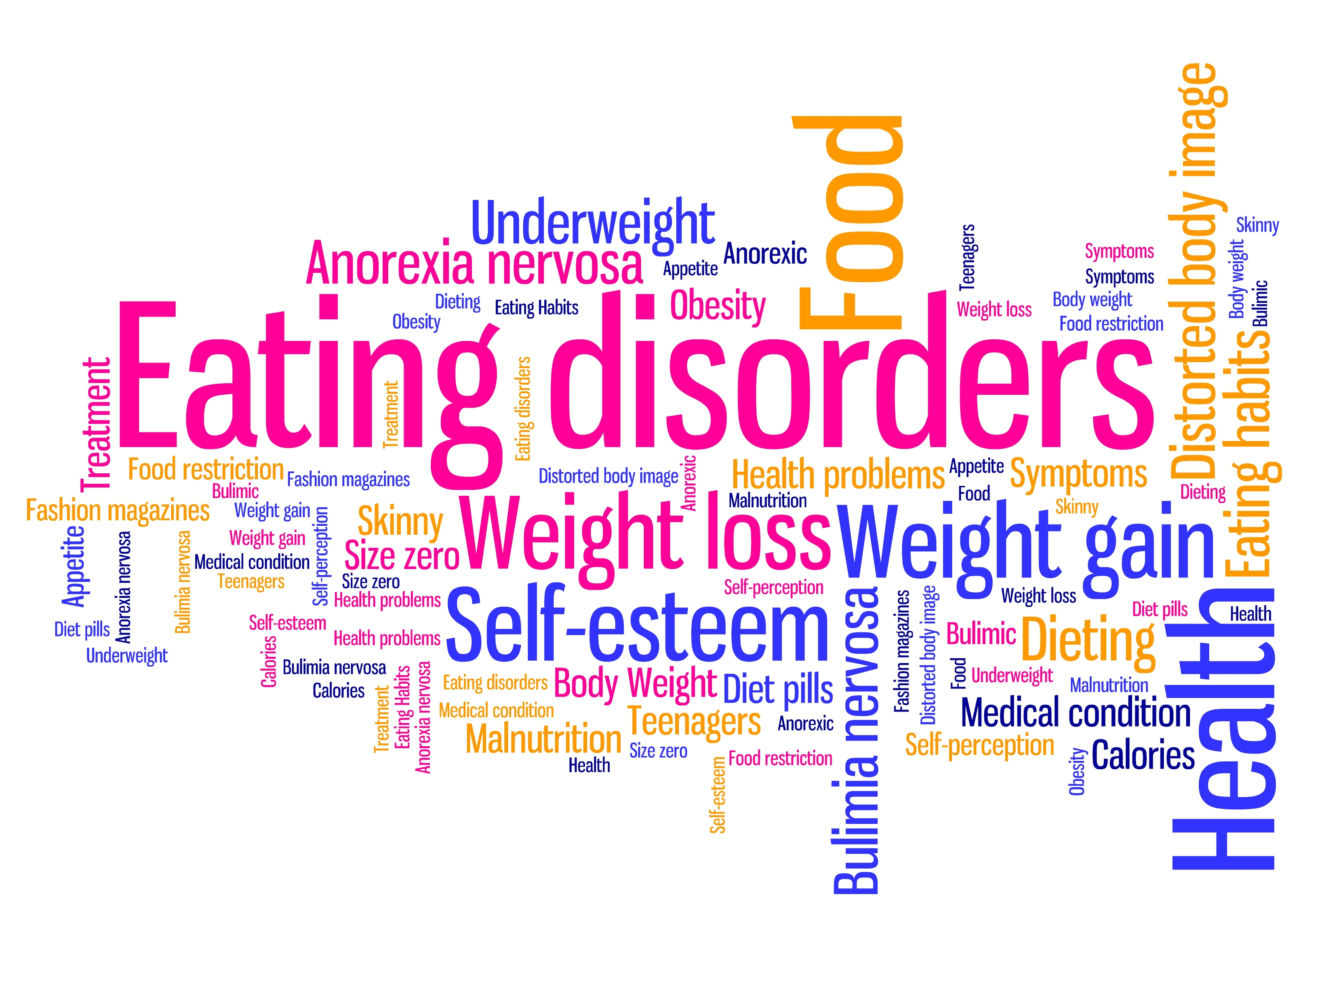
Eating Disorder
A disease that involves an unhealthy concern with one’s body weight and shape
Starving
Overeat

Slide 37
Anorexia Nervosa
Eating disorder that involves self- starvation, an unhealthy body weight, and extreme weight loss
Intense fear of being fat or gaining weight
Feel Fat
Eat foods low in calories or fat
May cause long term problems

Slide 38
Anorexia Nervosa Symptoms vs. Healthy person
Dry, dull hair and hair loss
Dry Skin
Brittle Nails
Large weight loss over a short period of time
Abdominal pain
Growth of fine body hair
Cold
Feel faint, light headed
Shiny, healthy hair
Healthy skin
Strong nails
Ability to maintain weight
Energetic

Slide 39
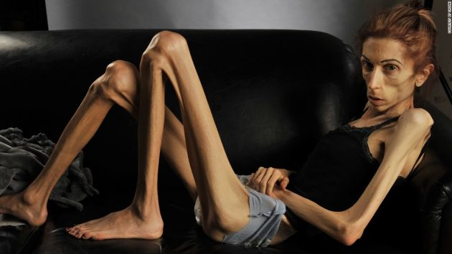

Slide 40
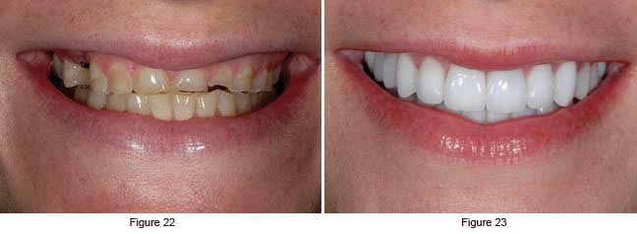
Bulimia Nervosa
Eating disorder in which a person eats a large amount of food and then tries to remove the food from his or her body
Bingeing
Purging

Slide 41
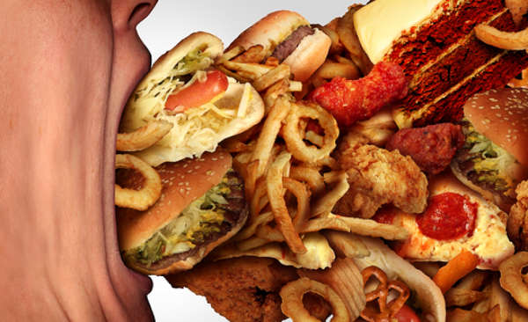
Binge Eating Disorder
Emotional Problems
Disease in which a person cannot control how much he or she eats
Do no purge
Junk food
Weight gain/ obesity

Slide 42
Healthy Weight Range

Slide 43
Fad Diets

